Slide 1
SETTLETRACE:-SETTLEMENT Q&A AGENT FOR FINTECH SUPPORT
AI-Powered Transaction Tracing & Settlement Explanation System
SMART ANSWERS .SEAMLESS SETTLEMENTS.ALWAYS
TEAM: BINARY NINJAS

Slide 2
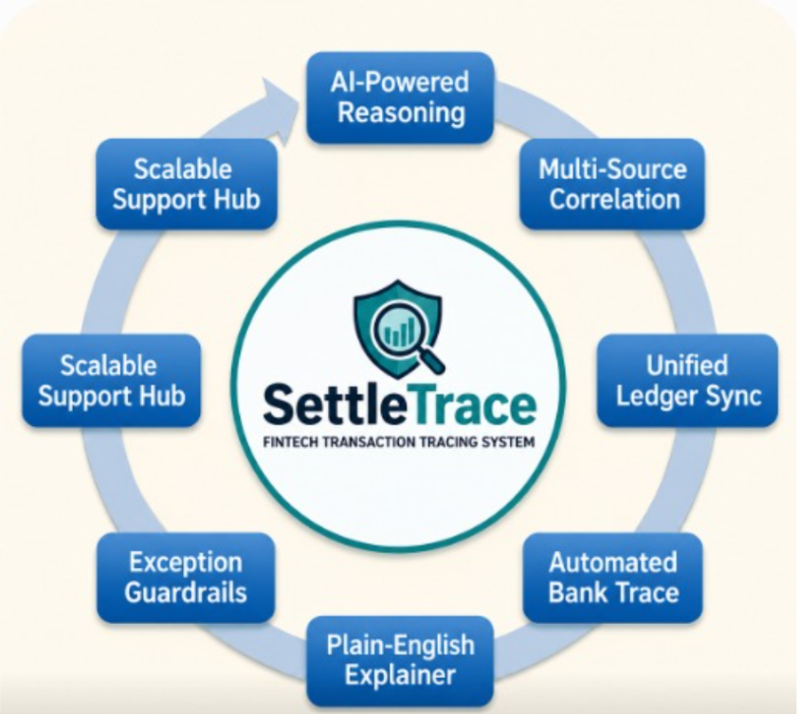
THE PROBLEM AND ITS SOLUTION
TRADITIONAL BANKING-THE FRICTION
Hidden Costs: Exchange rate markups and unclear pricing reduce transparency.
Slow Processing: International transfers often take several business days to complete.
High Fees: Wire transfer fees and intermediary charges increase total costs.
THE FIX
Fragmented Trail: Manual sifting through disparate payment, bank, and ledger logs.
Support Bottleneck: High manual effort limits resolution speed and team capacity.
Human Error: Disconnected record-checking increases misdiagnosis risk.

Slide 3

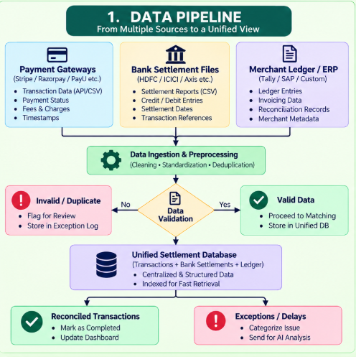
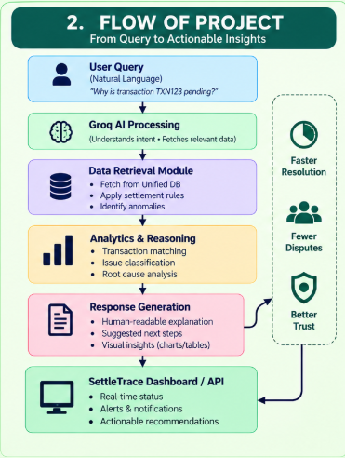

Slide 4
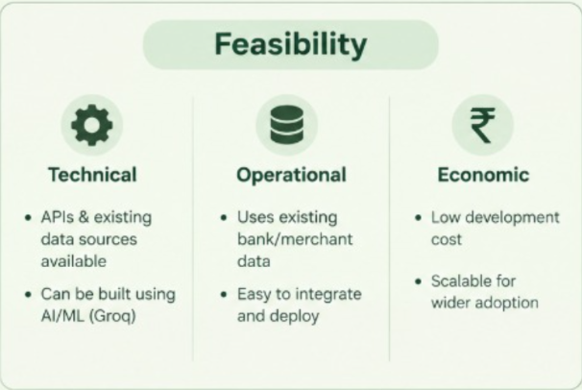
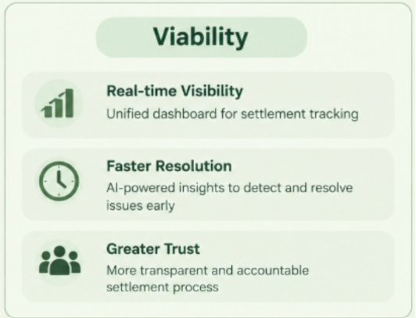
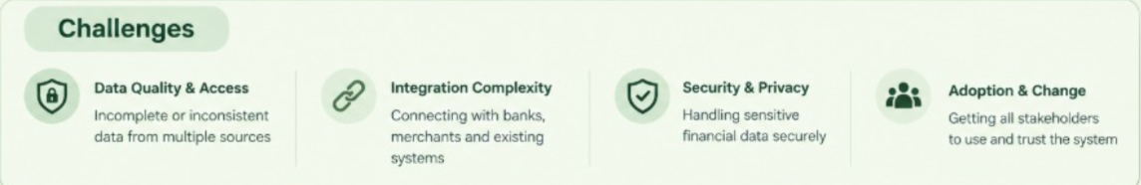

Slide 5
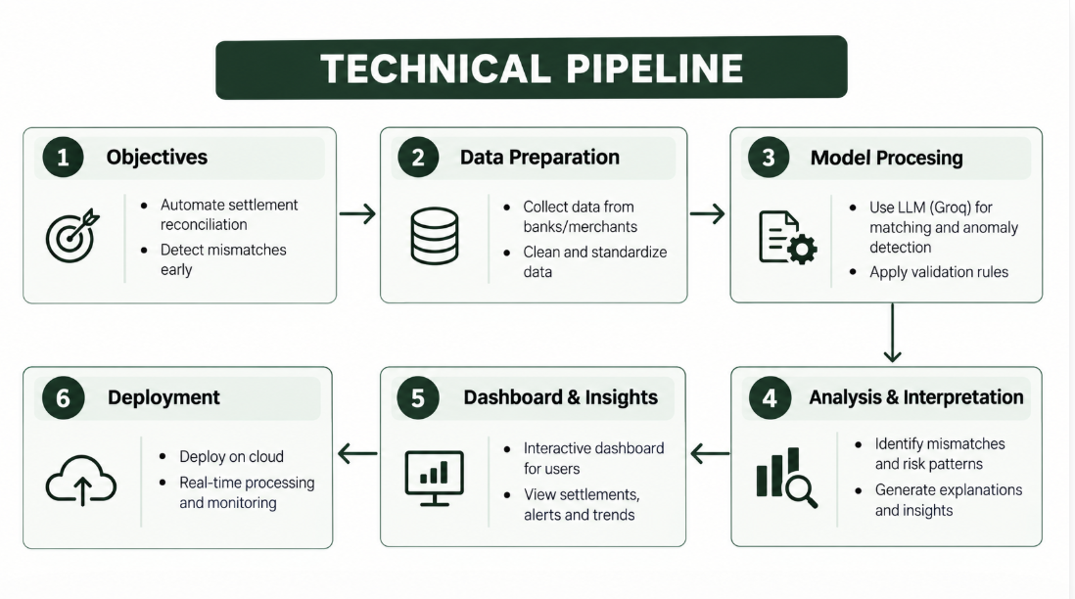

Slide 6
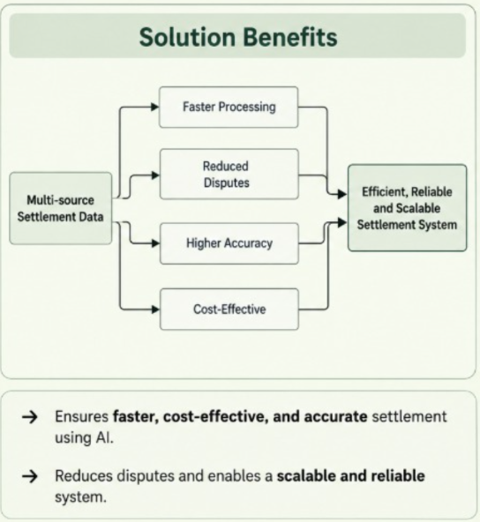
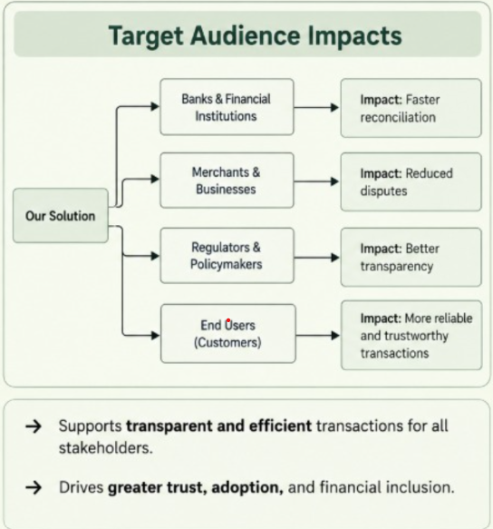

Slide 7
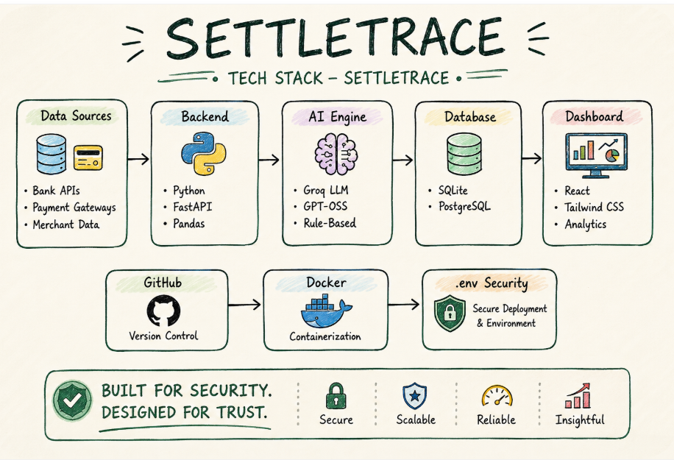

Slide 8
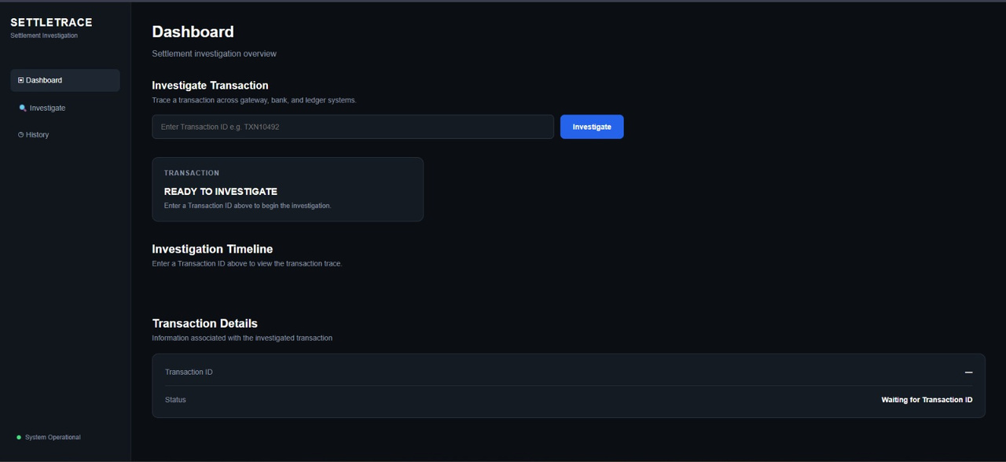
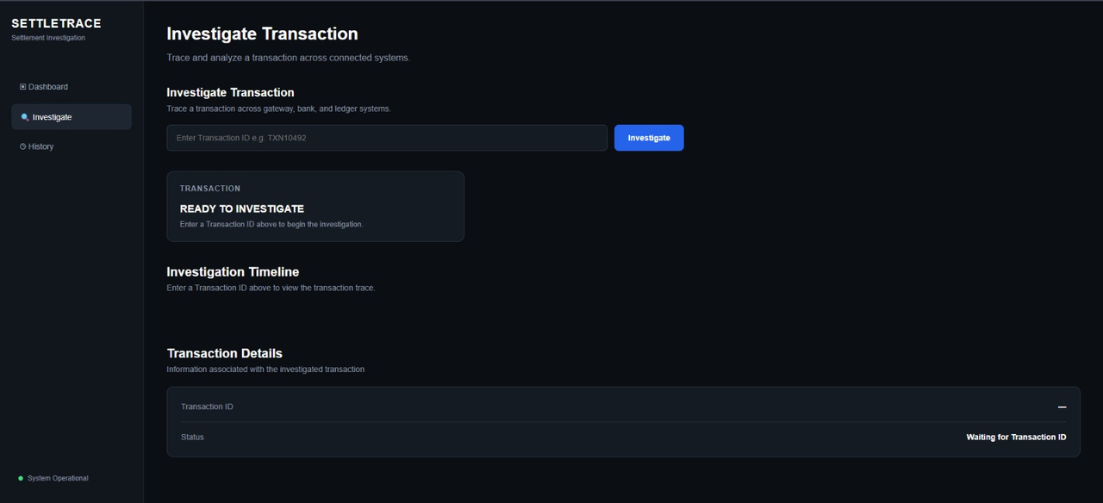
UI

Slide 9
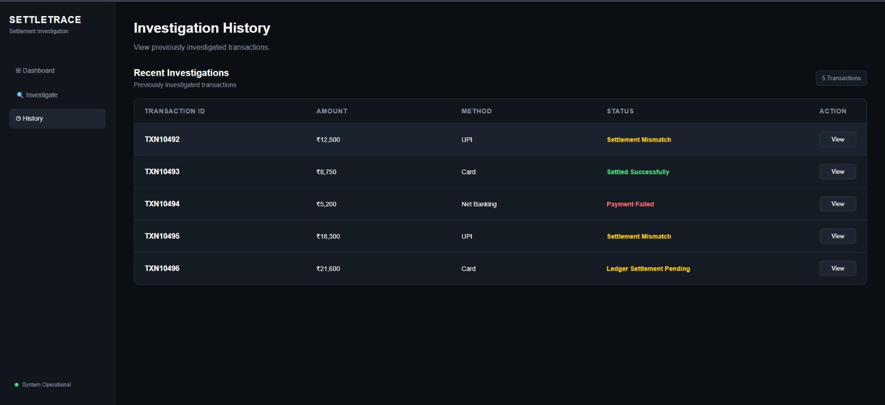

Slide 10
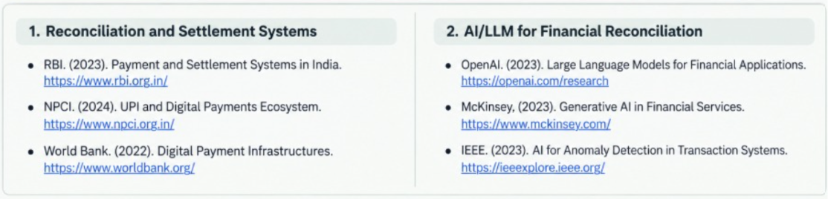
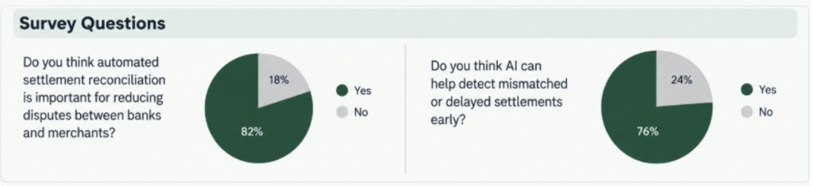

Slide 11
Thank You
Team:-binary ninjas
Team Members:-
Arjun P. Singh - 25BCE11078
Ananya Gupta - 25BCE10923
Astha Singh - 25BCE10626
Adwita Shrivastava - 25BCE10550
Dhruv Kumar - 25BSA10149

